Slide 1
Electronics Lab (Experiment-0)
P . Manoj Kumar
Roll no : 21IE10027

Slide 2
Objective of the Experiment
Transient and Frequency response of a RLC-circuit
To derive value of resistance of critical damping in transient analysis of a RLC circuit and plot the frequency response for frequency range 1Hz to 1THz .
CMOS Inverter
To plot the DC characteristics (V_{out} vs V_{in}) and I_{dd} vs V_{in} of a CMOS inverter and design the size of it such that you get the best Tr/Tf.

Slide 3
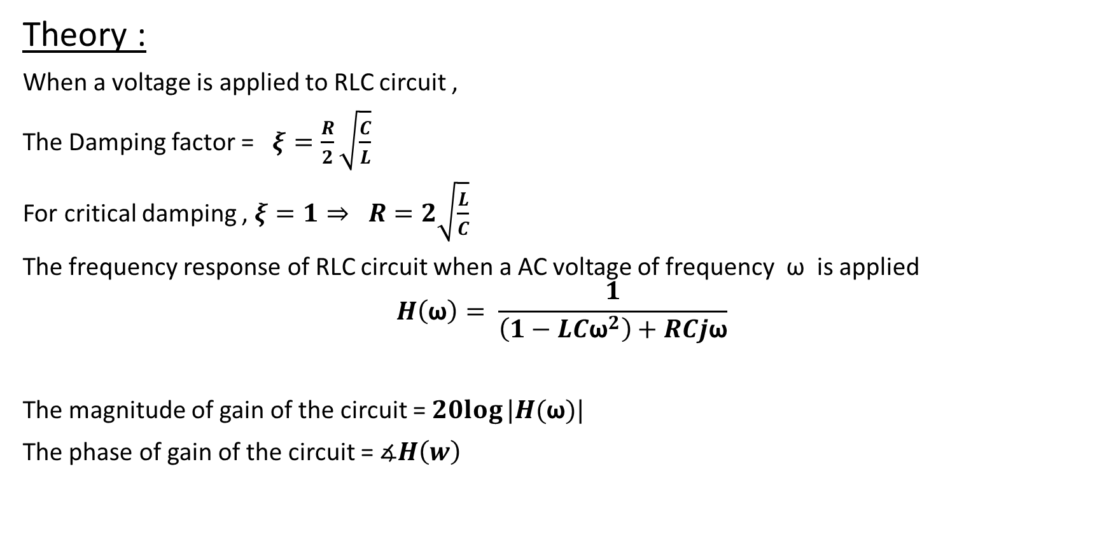
1. Transient and Frequency response of RLC circuit
Theory :
When a voltage is applied to RLC circuit ,
The Damping factor = $ξ=\frac{R}{2}\sqrt{\frac{C}{L}}$
For critical damping , $ξ=1⇒ R=2\sqrt{\frac{L}{C}}$
The frequency response of RLC circuit when a AC voltage of frequency ω is applied
$$H\left(\text{ω}\right)= \frac{1}{\left(1−LC{\text{ω}}^{2}\right)+RCj\text{ω}}$$
The magnitude of gain of the circuit = $20log⁡|H(\text{ω})|$
The phase of gain of the circuit = $∡H\left(w\right)$

Slide 4
List of Components
SL no. | Component | Rating | Quantity
1 | Battery | 5V DC , 1V AC source | 2,1
2 | Resistor | - | 1
3 | Capacitor | 1µF | 1
4 | Inductor | 1mH | 1
5 | Switch | - | 1
6 | Connecting wires | - | -

Slide 5
Procedures
The given circuit was created on LTSpice.
First , the circuit was excited with a dc voltage (pulse signal of 5V) and then the DC characteristics (V_{out} vs V_{in}) was plotted giving initial potential difference across the capacitor 0V.
Then the value of resistance was calculated by checking the critical damping conditions.
The DC characteristics (V_{out} vs V_{in}) was plotted giving initial potential difference across the capacitor 1V, 2V, 7V respectively.
After that, the circuit was excited with 1V AC source and the frequency response of the circuit ( both gain and phase plot )was plotted against frequency ranging from 1Hz to 1THz.

Slide 6
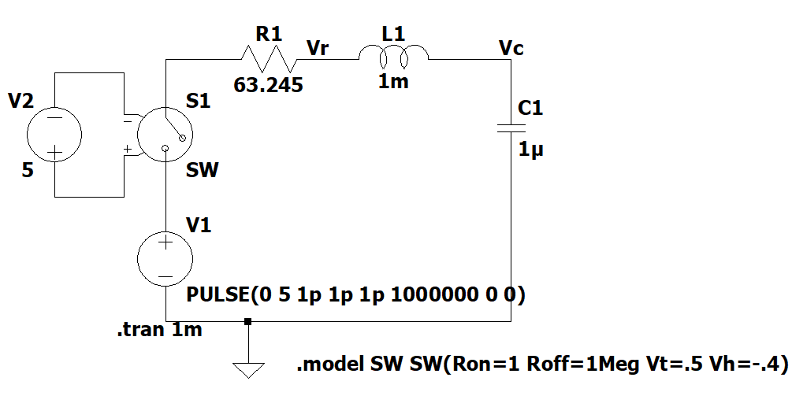
Circuit Diagram(Transient response)
Fig 1.1 - Circuit with DC source
The voltage is a pulse signal whose magnitude is 5V , rise-time and fall-time 1ps and time-period 0s.

Slide 7
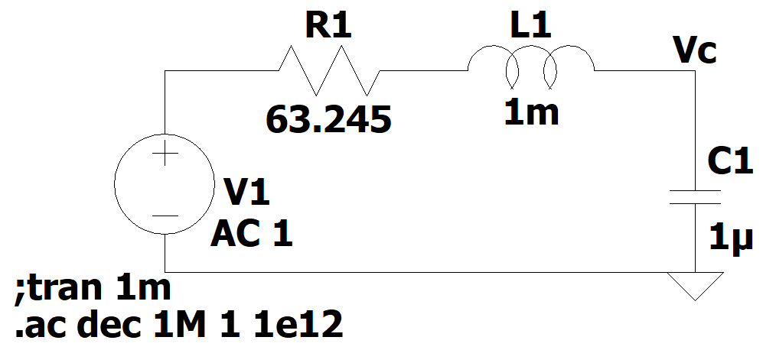
Circuit Diagram(Frequency response)
Fig 1.2 – Circuit with AC source for frequency response

Slide 8

Calculations
For critical damping , $R=2\sqrt{\frac{L}{C}}$
As L=1mH and C= 1µF
$$⇒R=2\sqrt{\frac{{10}^{−3}}{{10}^{−6}}}=63.245 Ω$$

Slide 9
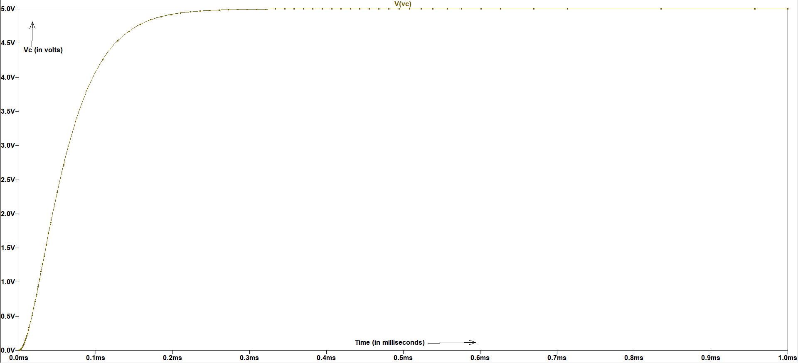
Graph 1.1
Fig 1.3 – V_{out} vs V_{in} plot (Initial voltage of capacitor is zero)

Slide 10
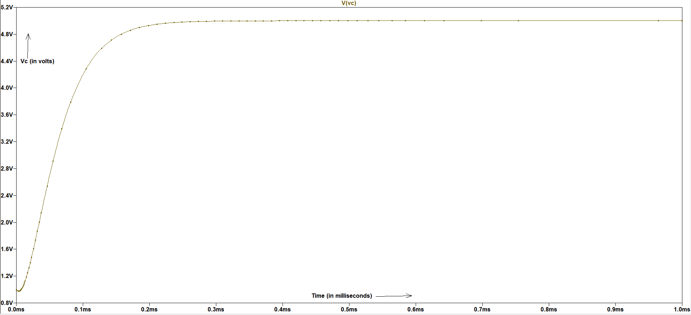
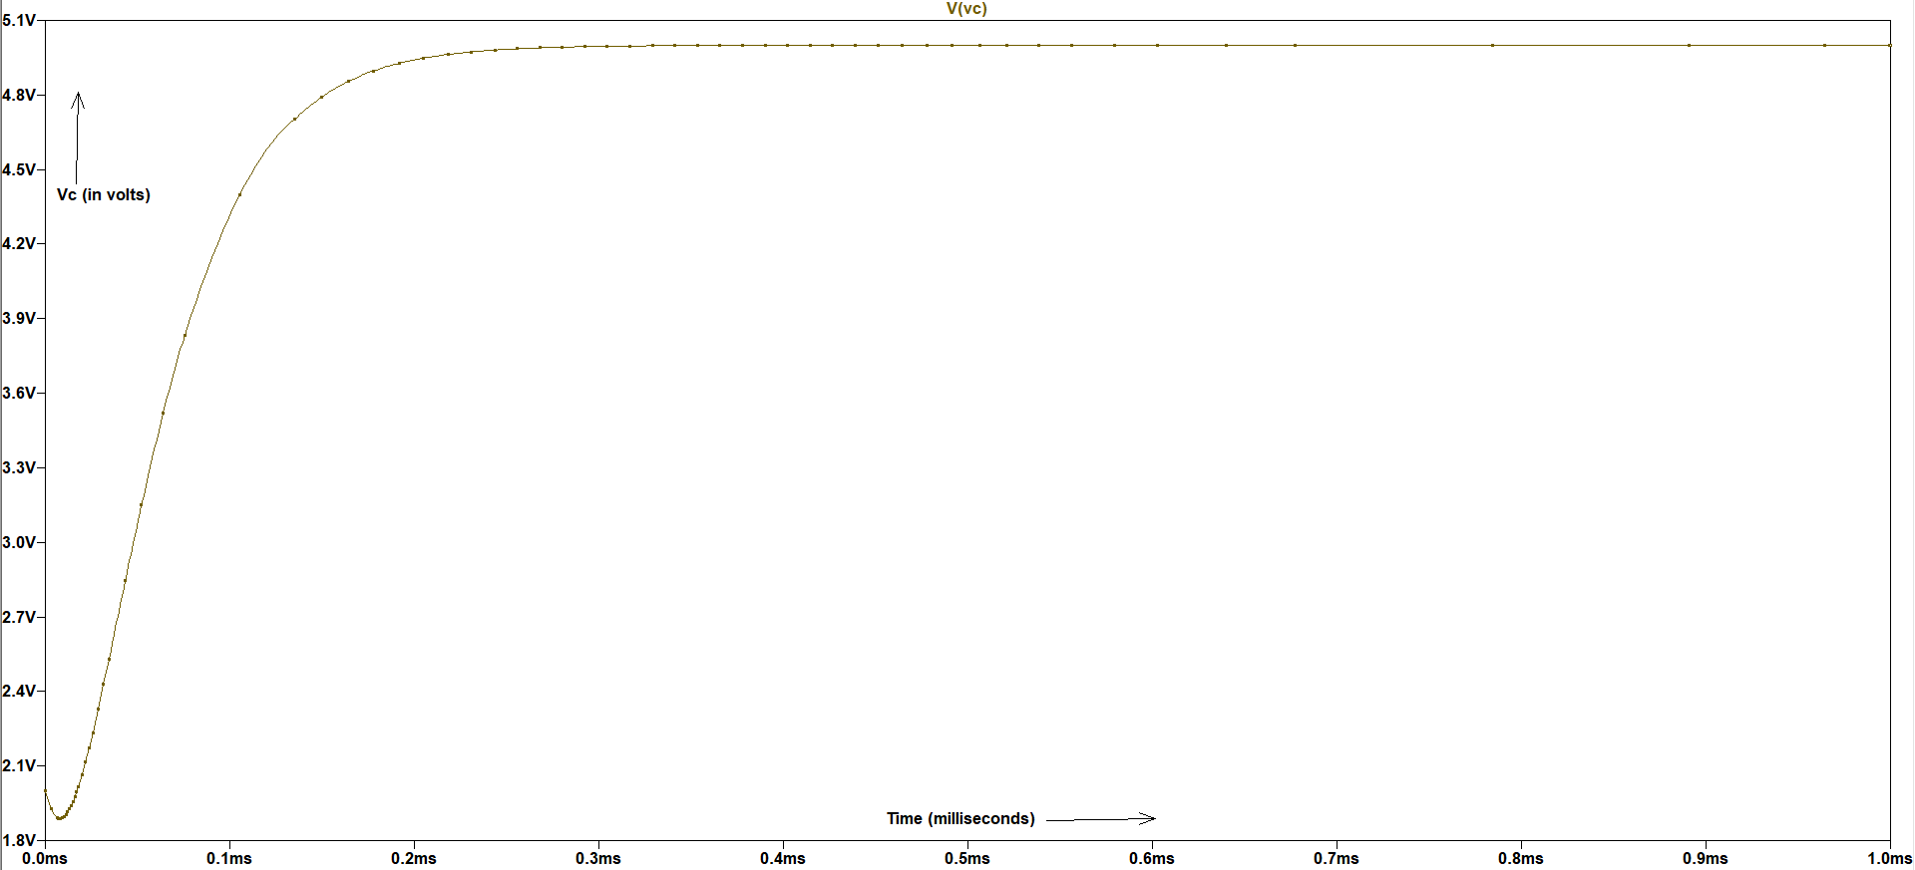
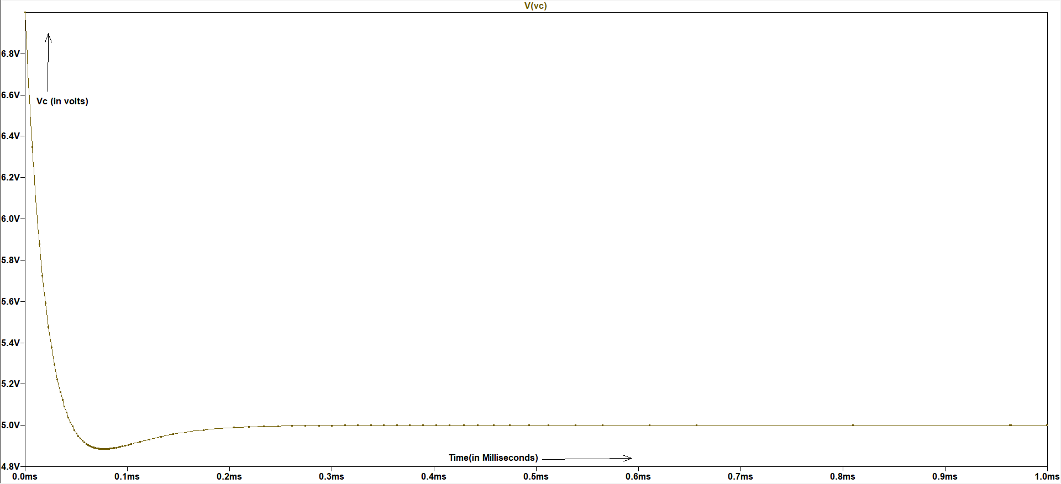
Graph 1.2
Fig 1.4 – V_{c} vs V_{in} plot (Initial voltage of capacitor is 1V) Fig 1.5 – V_{c} vs V_{in} plot (Initial voltage of capacitor is 2V)
In all three conditions , the final potential difference across the capacitor
is 5V, which is independent of the initial potential diff. across capacitor.
Fig 1.6 – V_{c} vs V_{in} plot (Initial voltage of capacitor is 7V)

Slide 11
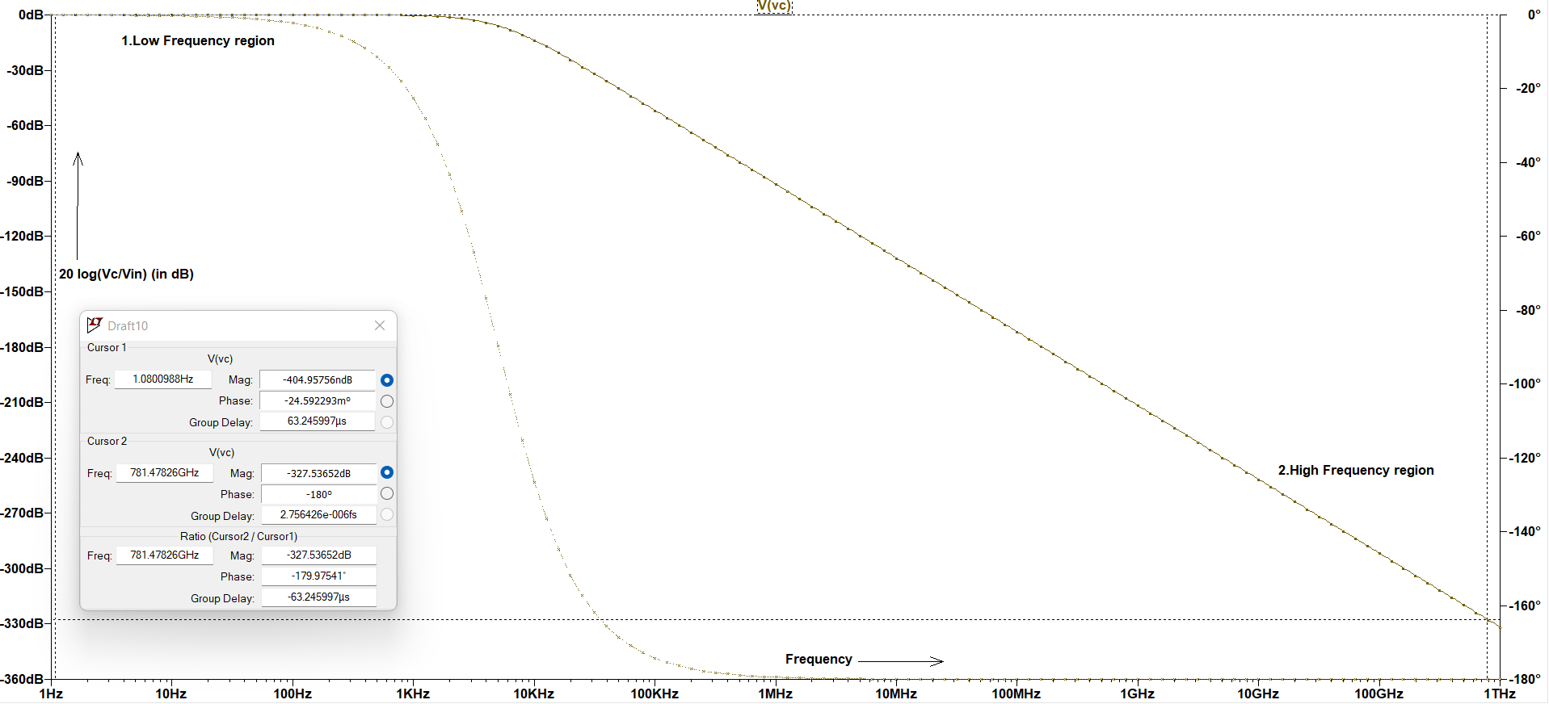
Graph 1.3
Fig 1.7 – Gain(in dB) and Phase plot in AC analysis
The value of gain in low-frequency region remains 0 dB and as the frequency increases (beyond 10KHz) ,the gain is decreasing at a rate of 40dB/decade. The phase will vary from 0 degree to -180 degree .

Slide 12
Observations and Discussions
The value of resistance in critical damping condition doesn’t depend on the value of initial potential difference across the capacitor as observed from the graphs (Graph 1.2).
In frequency response graph , the gain will decrease at a rate of 40 dB/decade after the cut-off frequency and remains 0dB in low-frequency range.
The phase of gain varies from 0° (at low frequencies) to -180° (at high frequencies).

Slide 13
2. CMOS Inverter
Theory :
A CMOS Inverter is a combination of PMOS and NMOS transistors where PMOS is arranged
at the top and NMOS is arranged at the bottom. It inverts the input signal.
Rise-Time : The time required for the output signal changing from 10% to 90% of the
drain voltage.
Fall-Time : The time required for the output signal changing from 90% to 10% of the
drain voltage.

Slide 14
List of Components
SL no. | Components | Rating | Quantity
1 | Battery | 5V,3V | 1,1
2 | NMOS | - | 1
3 | PMOS | - | 1
4 | Capacitor | 100fF | 1
5 | Connecting wires | - | -

Slide 15
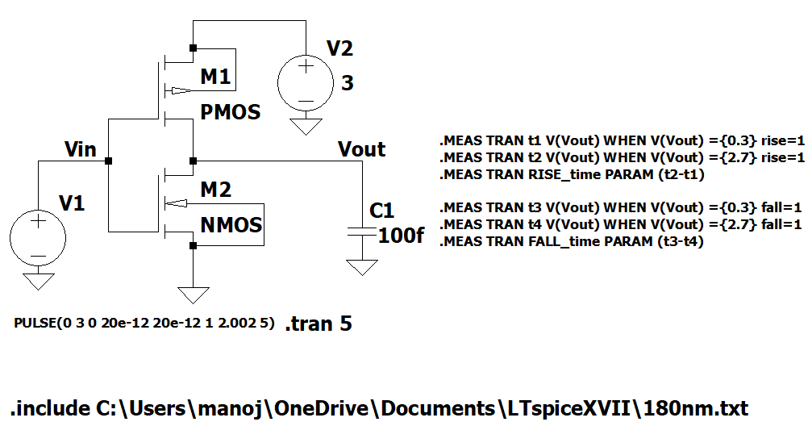
Circuit Diagram
Fig 2.1 – CMOS Inverter
The practical model 180nm.txt was used for the pmos and nmos transistors. The voltage is a pulse signal whose magnitude is 3V , rise-time and fall-time 20ps, time-period 2.002s and the duration of the positive voltage is 1s. On the right side , commands were used to calculate the rise time and fall time.

Slide 16
Procedures
The given was created on LTSpice.
The PMOS and NMOS were sized (W/L)in such a way that the we will get the best rise time or fall time by giving V_{dd}=3V .
The values of rise-time and fall-time were tabulated for some values of width of PMOS keeping the width of NMOS fixed (36 µm).
The DC characteristics of CMOS Inverter (V_{out} vs V_{in} and I_{dd} vs V_{in} ) were plotted.
After that, PMOS and NMOS were switched and step-3 was repeated .

Slide 17
Observation Table
Width of PMOS (in µm) | Rise Time ( in ps) | Fall Time (in ps) | Rise time/Fall time
72 | 16.9558 | 13.0693 | 1.297
79 | 16.3545 | 13.0969 | 1.249
80 | 16.2617 | 13.1877 | 1.233
81.79047 | 16.2668 | 13.2104 | 1.231 (minimum)
82 | 16.2461 | 13.1731 | 1.238
83 | 16.2186 | 13.1243 | 1.236

Slide 18
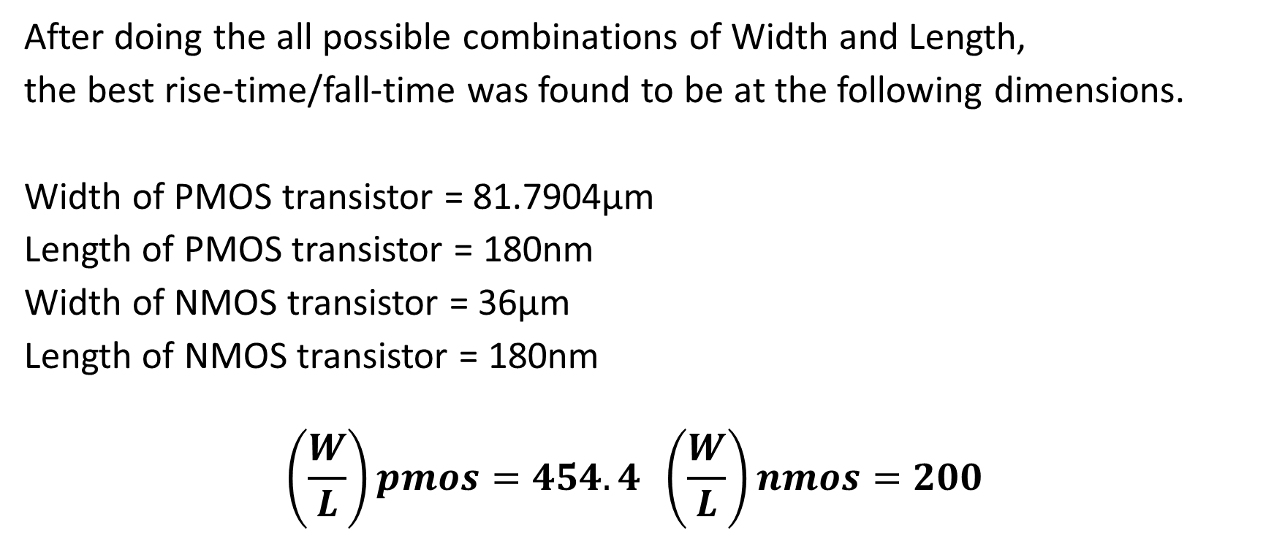
Sizing the CMOS Inverter
After doing the all possible combinations of Width and Length,
the best rise-time/fall-time was found to be at the following dimensions.
Width of PMOS transistor = 81.7904µm
Length of PMOS transistor = 180nm
Width of NMOS transistor = 36µm
Length of NMOS transistor = 180nm
$$\left(\frac{W}{L}\right)pmos=454.4 \left(\frac{W}{L}\right)nmos=200$$

Slide 19
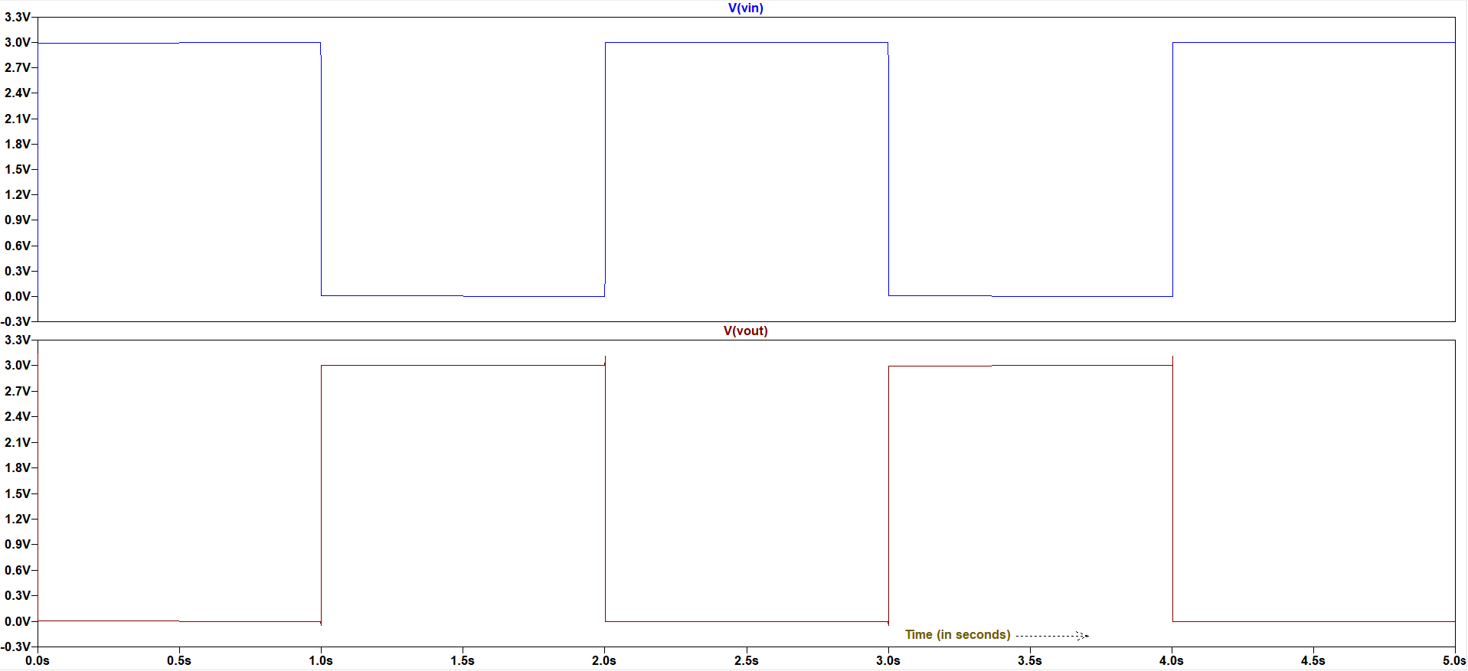
Graph 2.1
Fig 2.2 - V_{out} and V_{in} plots of CMOS Inverter
The output waveform is inverted w.r.t the input waveform.

Slide 20
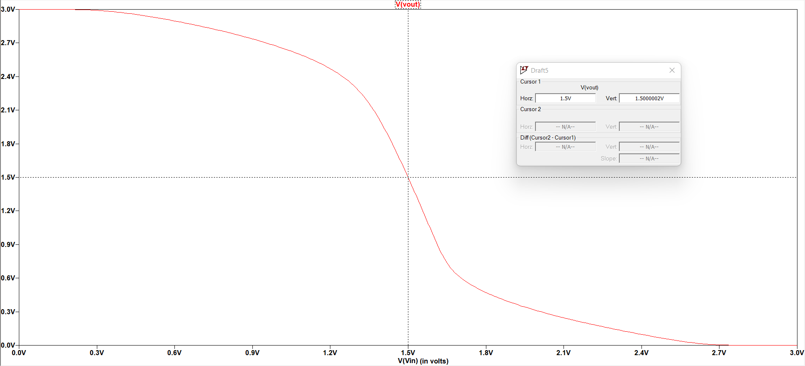
Graph 2.2
Fig 2.3 – V_{out} vs V_{in} of CMOS Inverter
After sizing the pmos and nmos, the transition point was achieved at the middle of the input range (1.5 V).

Slide 21
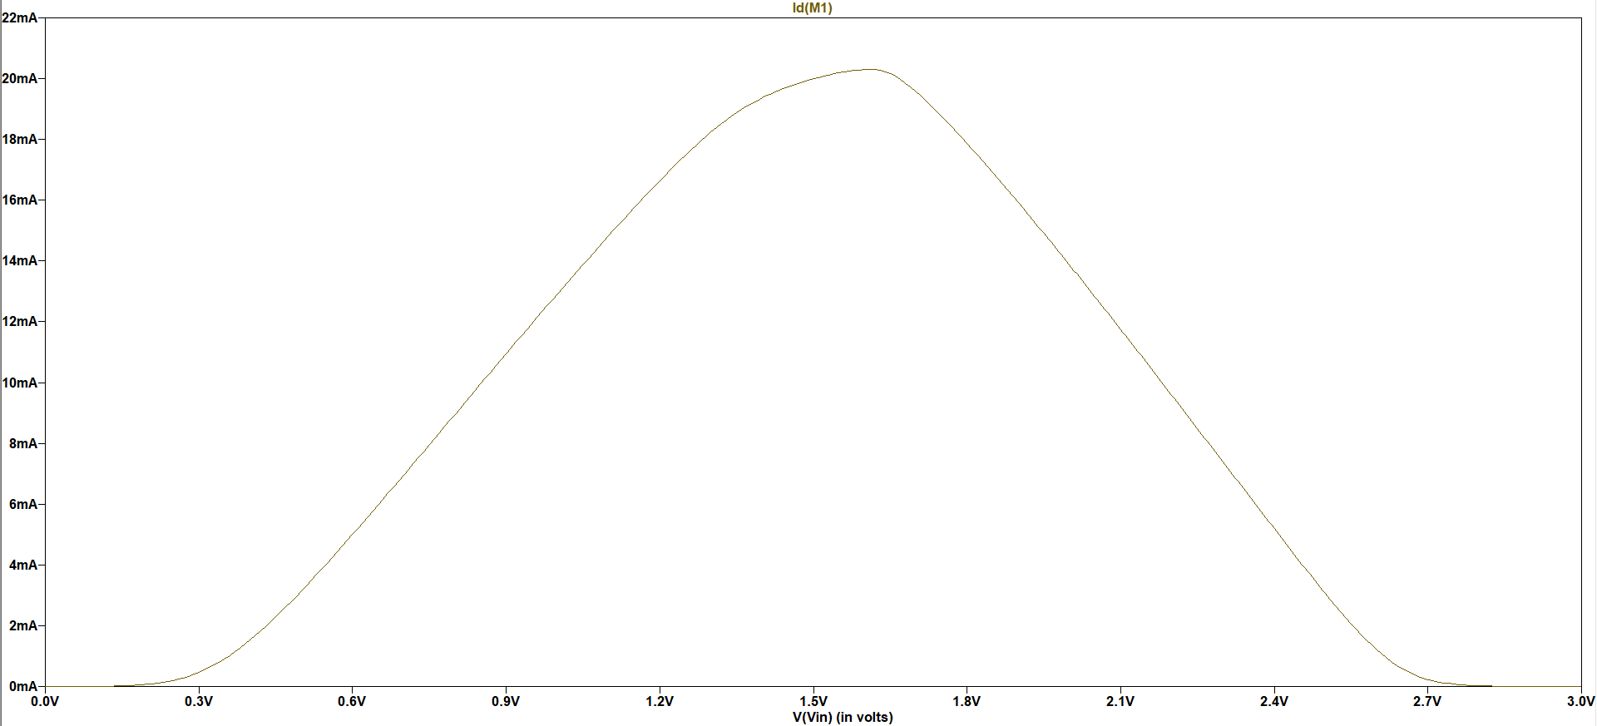
Graph 2.3
Fig 2.4 – I_{dd} vs V_{in} of CMOS Inverter

Slide 22
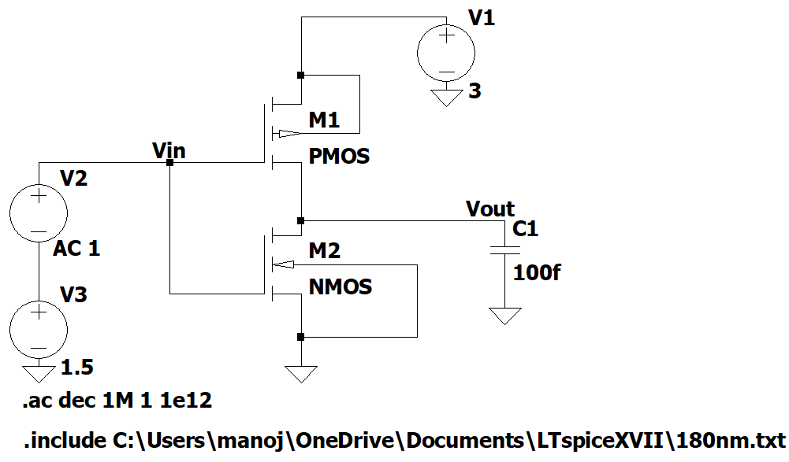
Circuit diagram(Frequency Response)
Fig -2.5 – Circuit diagram for AC response of cmos inverter
The ac analysis was performed across the bias point (V_{dc}=1.5 V) such that maximum gain could be gained.

Slide 23
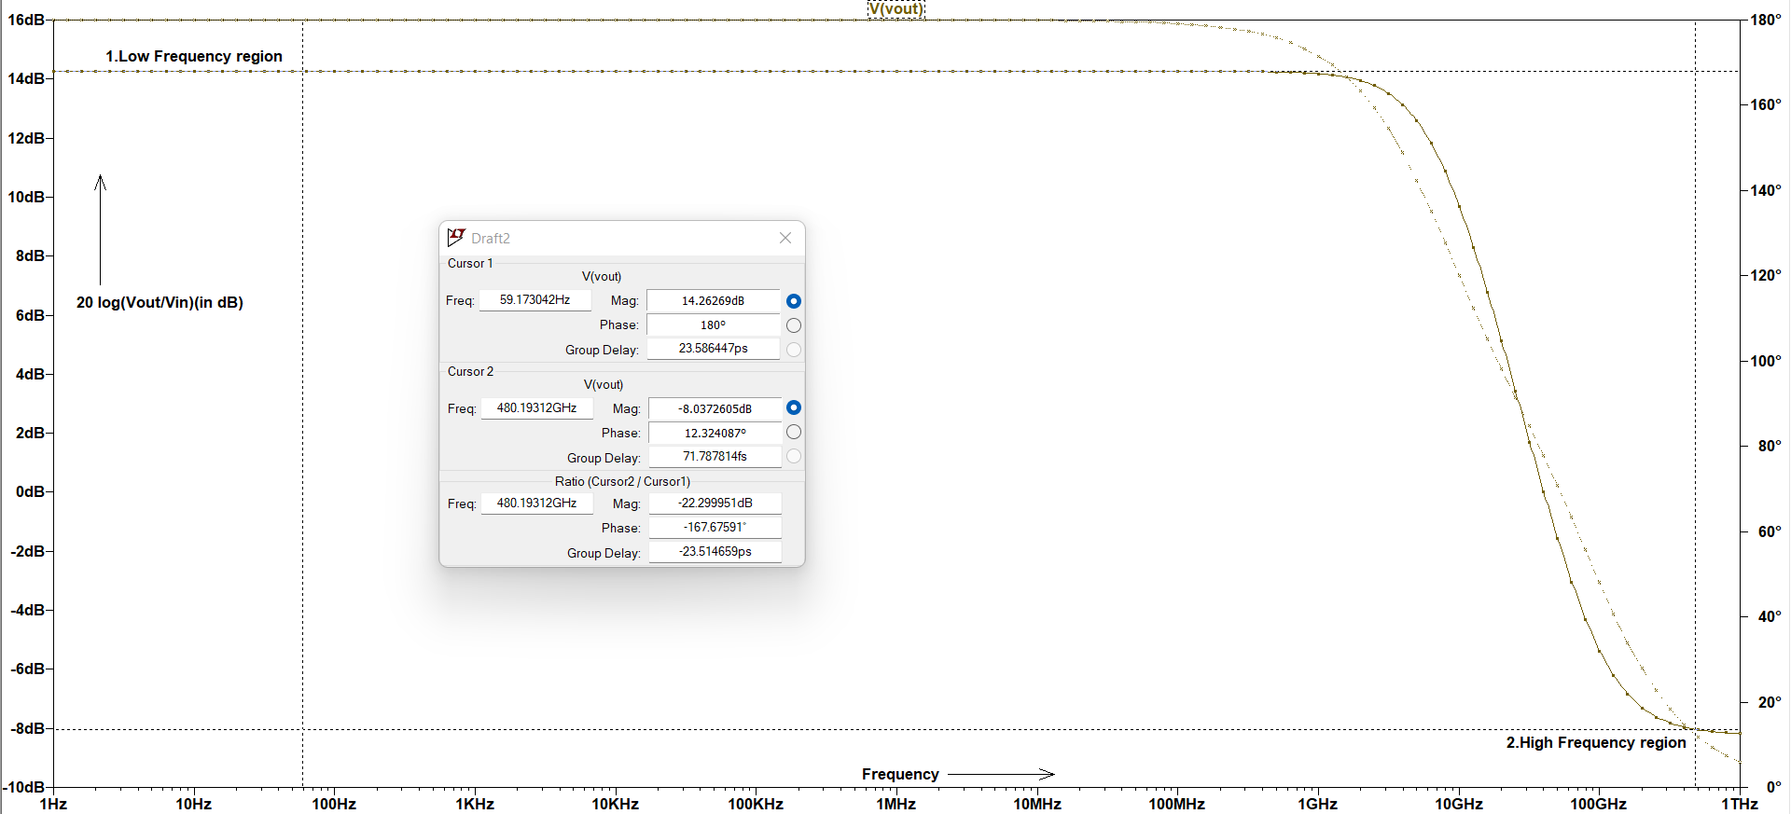
Graph-2.4
Fig-2.6 – Frequency Response (Gain (in dB) and phase (in degree))
The value of gain in low-frequency region remains 14.26dB (maximum gain) and as the frequency increases (beyond 1GHz) ,the gain is decreasing till -8dB . The phase is changing from 180 degrees to 0 degree.

Slide 24
How Tr/Tf is related to DC Characteristics
The rise time or fall time of a CMOS inverter is related to its DC characteristics in that it is a measure of the speed of the output transition from low to high or high to low.
The Tr/Tf values depend on the circuit components, including the load capacitance, the MOSFET channel length, and the applied supply voltage, among other things.
A smaller Tr/Tf value indicates a faster transition and higher performance, while a larger value indicates a slower transition and lower performance.

Slide 25
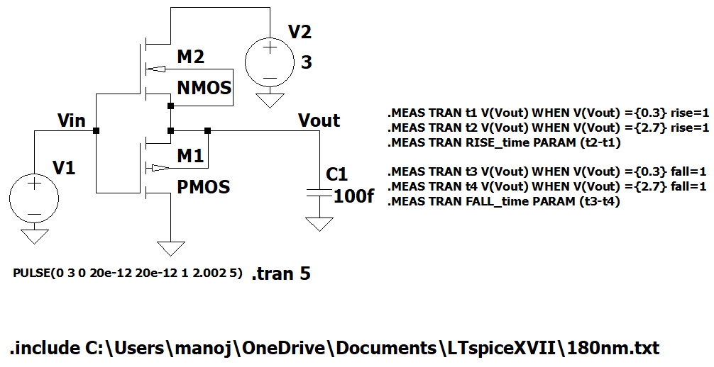
Circuit Diagram
Fig 2.5 – CMOS Inverter (switching PMOS and NMOS)
The practical model 180nm.txt was used for the pmos and nmos transistors. The voltage is a pulse signal whose magnitude is 3V , rise-time and fall-time 20ps, time-period 2.002s and the duration of the positive voltage is 1s. On the right side , commands were used to calculate the rise time and fall time. The position of pmos and nmos were switched .

Slide 26
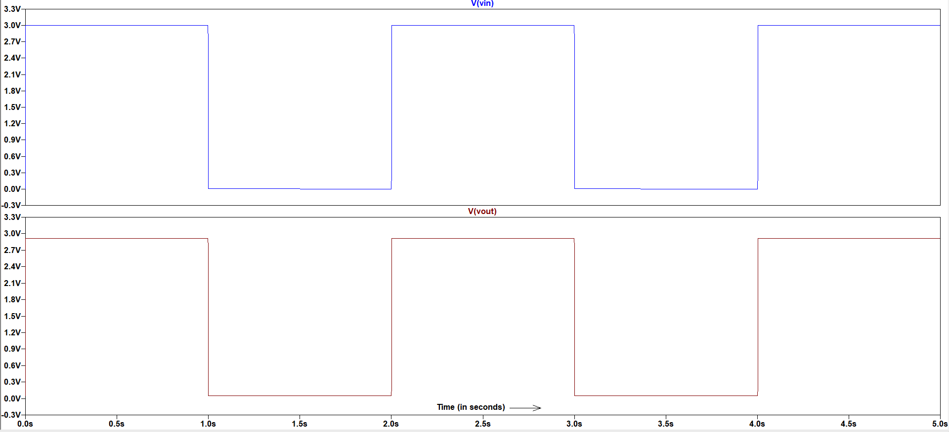
Graph 2.4
Fig 2.6 – V_{out} and V_{in} plots w.r.t time
The output waveform is same as the input waveform. It acts likes a buffer rather than an inverter.

Slide 27
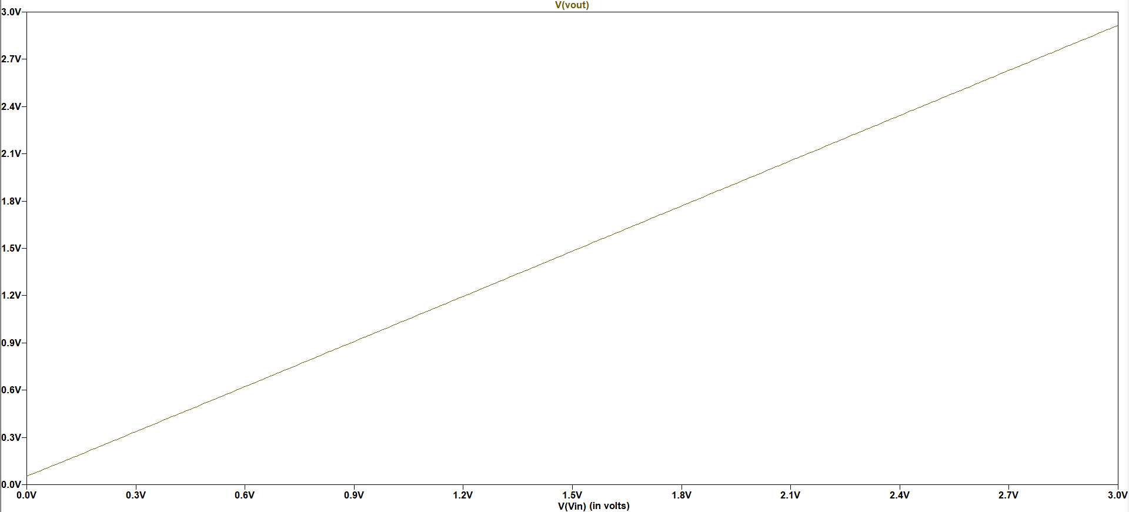
Graph 2.5
Fig 2.7 – V_{out}vs V_{in} plot
The output voltage is directly proportional to input voltage.

Slide 28
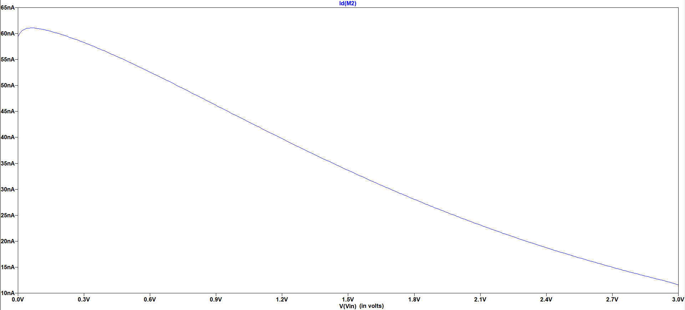
Graph 2.6
Fig 2.8 – I_{dd} vs V_{in} plot

Slide 29
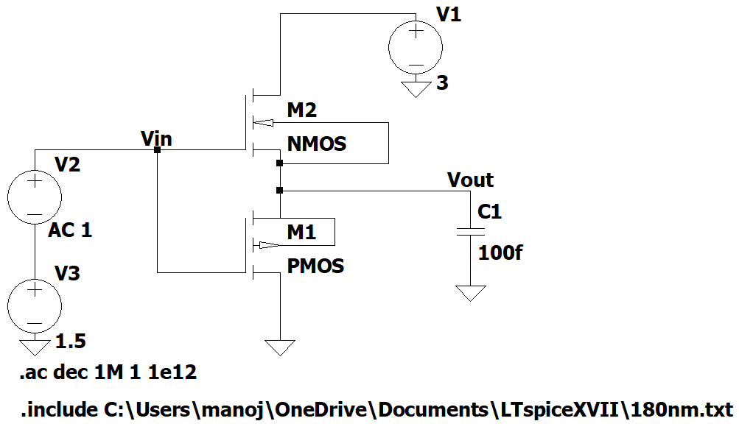
Circuit Diagram
Fig -2.8 – Circuit diagram for AC response of cmos inverter (after switching pmos and nmos)
The ac analysis was performed across the bias point (V_{dc}=1.5 V) such that maximum gain could be gained.

Slide 30
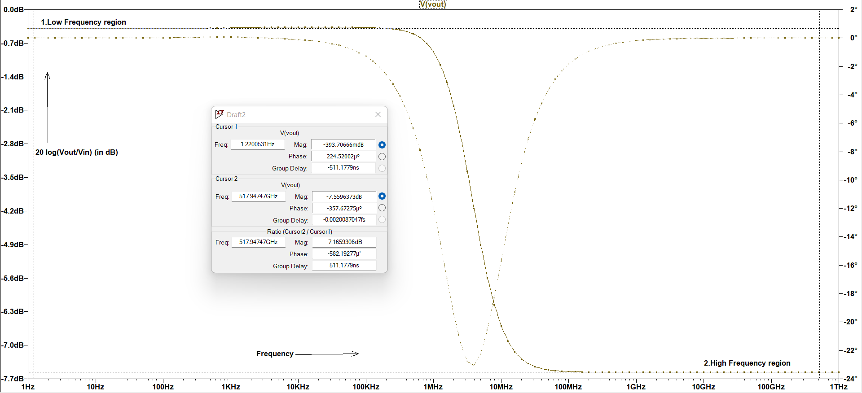
Graph-2.7
Fig-2.9 – Frequency Response (Gain (in dB) and phase (in degree))
The value of gain in low-frequency region remains -393.8mdB (maximum gain) and as the frequency increases (beyond 1MHz) ,the gain is decreasing till -7.6dB . The phase decreases from 0 degree to -23 degree and then again increases to 0 degree.

Slide 31
Observations and Discussions
The size ratio of PMOS and NMOS transistor was found to be approximately equal to 2.27, also theoretically , the value of size ratio of PMOS and NMOS should be between 2-3. Because, the ratio of mobility of electrons and protons is 2.3.
After switching PMOS and NMOS of CMOS Inverter , it basically acts as a buffer, means it doesn’t invert the input signal.
For obtaining maximum gain, the dc operating point of the inverter should be 1.5V.

Slide 32
Thank You !

